Slide 1
Concierge Desk Performance Review
Fiscal Year 2025. Prepared for James Whitfield, Director of Guest Services.
Elizabeth Robles, Senior Concierge

Slide 2
The Year at a Glance
Four numbers that summarize the desk
4.9 / 5
1,268
Exceeds
16th yr
Average VIP guest satisfaction
VIP requests fulfilled
Annual rating from the director
Tenure on property
The desk carried the heaviest VIP load through the marquee art fair in December and the holiday peak without a single escalation reaching the director's office. Latin American and European guest relationships continued to grow on the strength of bilingual service.
Source, concierge desk logs and guest satisfaction surveys, FY2025

Slide 3
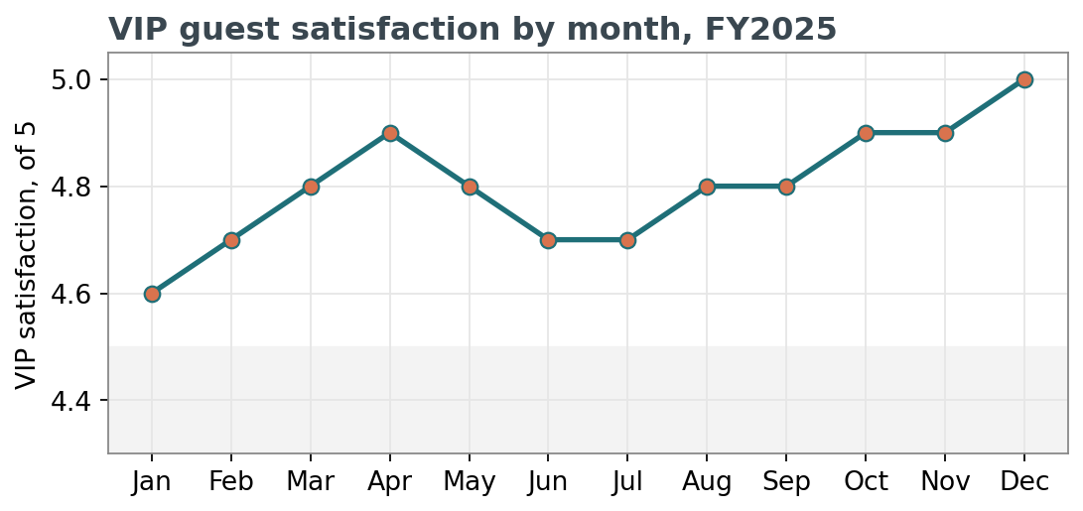
Guest Satisfaction Held High
Steady through the busiest months
Satisfaction never dipped below 4.6 and closed the year at a full 5.0 in December, the single busiest month.
Lowest months still tracked above the property target of 4.5.
Scores collected from post stay VIP surveys

Slide 4
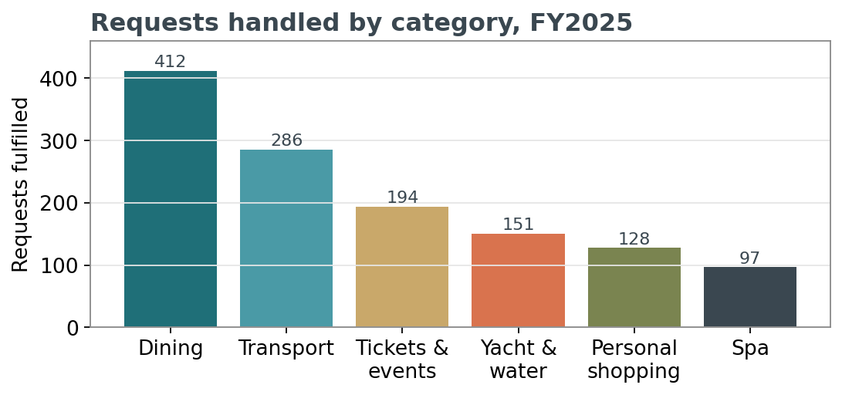
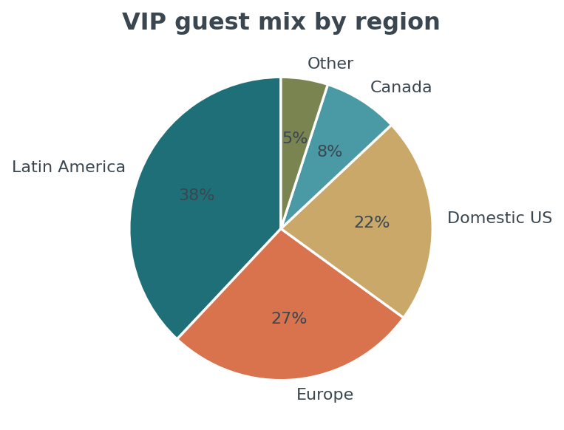
Where the Work Goes
Volume by category and guest origin
Dining and transport remain the backbone of daily requests

Slide 5
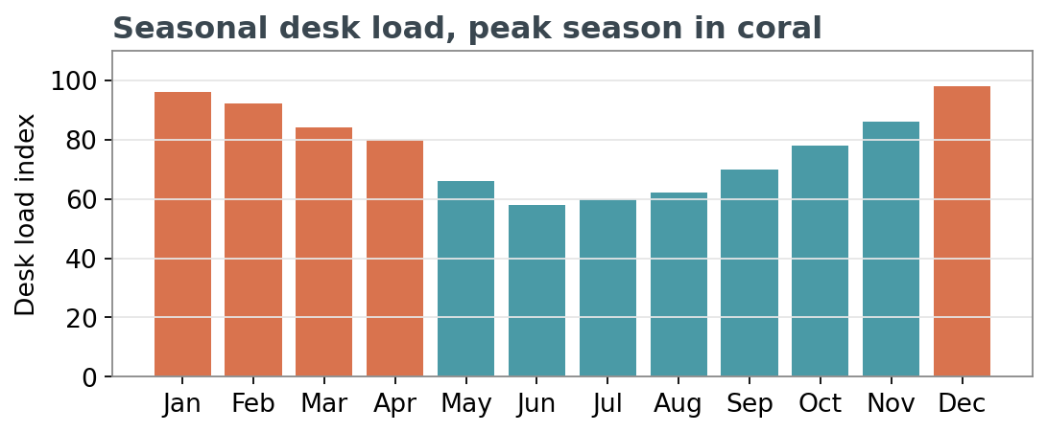
A Seasonal Business
Peak season runs December through April
the marquee art fair in December and the snowbird and spring break months drive the heaviest load.
Summer brings a different mix, more Latin American and European family travel.
Staffing and coverage planned around this curve

Slide 6
Goals for FY2026
Building on a strong year
Pre arrival profiles
Pilot a VIP pre arrival profile system so repeat guests are known before they walk in.
Cross train the bench
Bring two junior concierges up on luxury vendor sourcing to protect coverage.
A leadership track
Open a formal path toward a lead or assistant manager role by the midyear review.
Discussed and agreed in the October performance review

